Slide 1
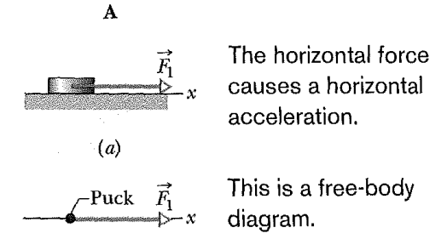
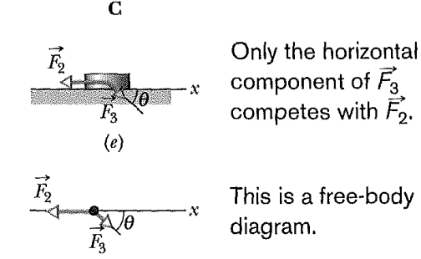
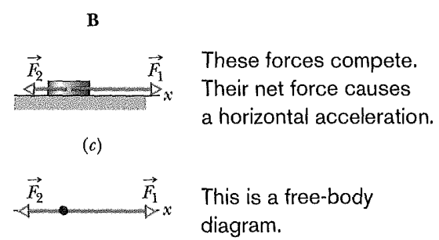
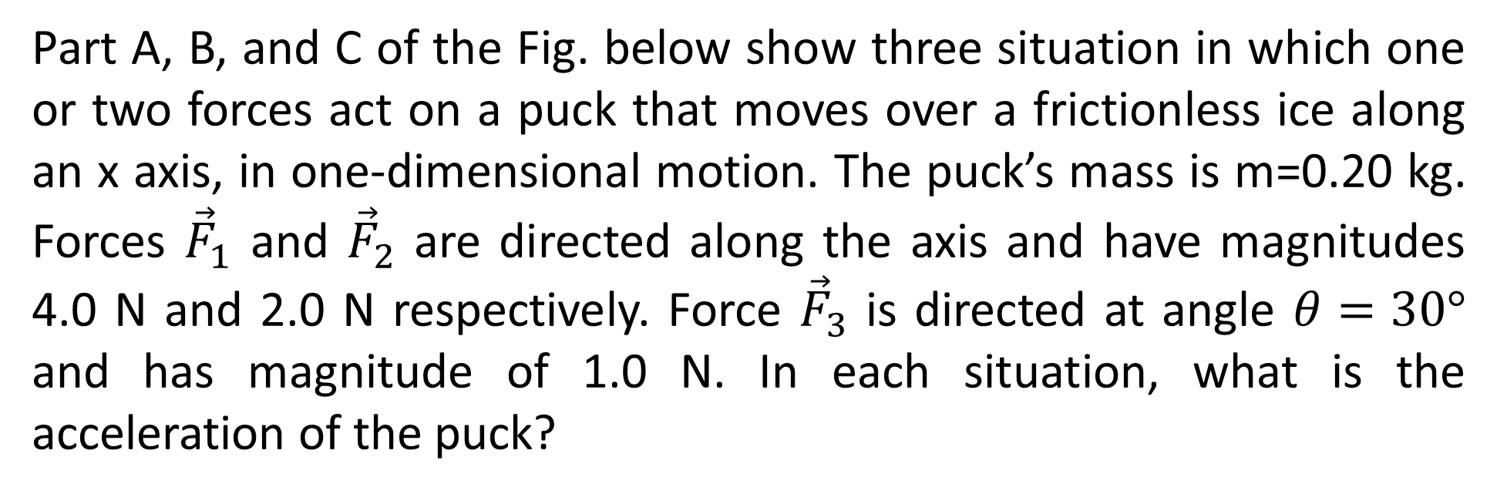
Part A, B, and C of the Fig. below show three situation in which one or two forces act on a puck that moves over a frictionless ice along an x axis, in one-dimensional motion. The puck’s mass is m=0.20 kg. Forces ${\vec{F}}_{1}$ and ${\vec{F}}_{2}$ are directed along the axis and have magnitudes 4.0 N and 2.0 N respectively. Force ${\vec{F}}_{3}$ is directed at angle $θ=30°$ and has magnitude of 1.0 N. In each situation, what is the acceleration of the puck?

Slide 2
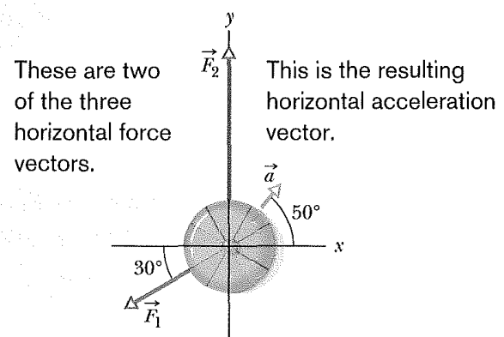
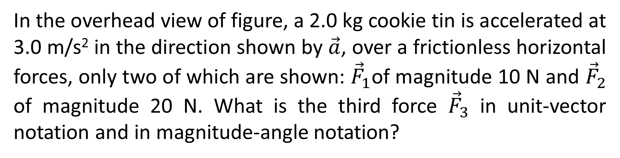
In the overhead view of figure, a 2.0 kg cookie tin is accelerated at 3.0 m/s² in the direction shown by $\vec{a}$, over a frictionless horizontal forces, only two of which are shown: ${\vec{F}}_{1}$of magnitude 10 N and ${\vec{F}}_{2}$ of magnitude 20 N. What is the third force ${\vec{F}}_{3}$ in unit-vector notation and in magnitude-angle notation?

Slide 3


$${40}^{°}$$
$${\vec{F}}_{3}$$

Slide 4
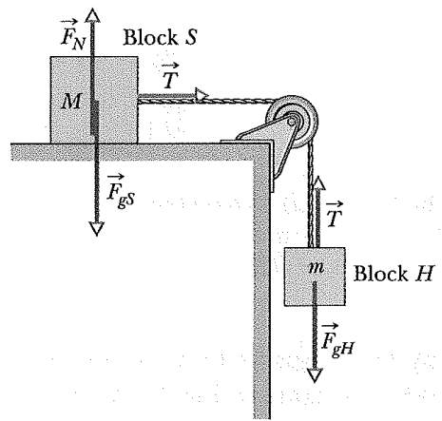
Figure shows a block S (the sliding block) with mass M=3.3 kg. The block is free to move along a horizontal frictionless surface and connected, by a cord that wraps over a frictionless pully, to a second block H (the hanging block), with mass m=2.1 kg. The cord and pulley have negligible masses compared to the blocks (they are “massless”). The hanging block H falls as the sliding block S accelerates to the right. Find (a) the acceleration of block S, (b) the acceleration of block H, and (c) the tension in the cord.

Slide 5
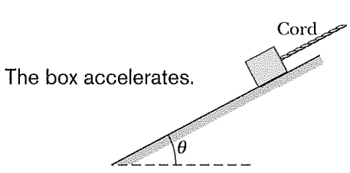
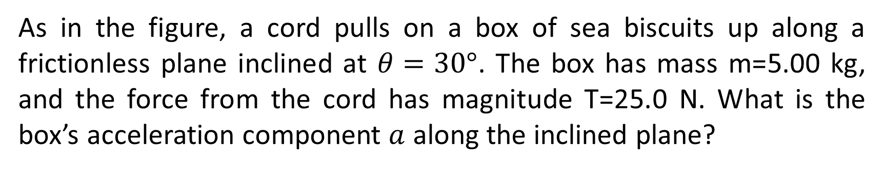
As in the figure, a cord pulls on a box of sea biscuits up along a frictionless plane inclined at $θ=30°$. The box has mass m=5.00 kg, and the force from the cord has magnitude T=25.0 N. What is the box’s acceleration component $a$ along the inclined plane?

Slide 6
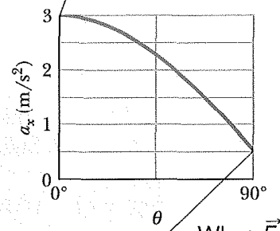
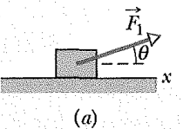
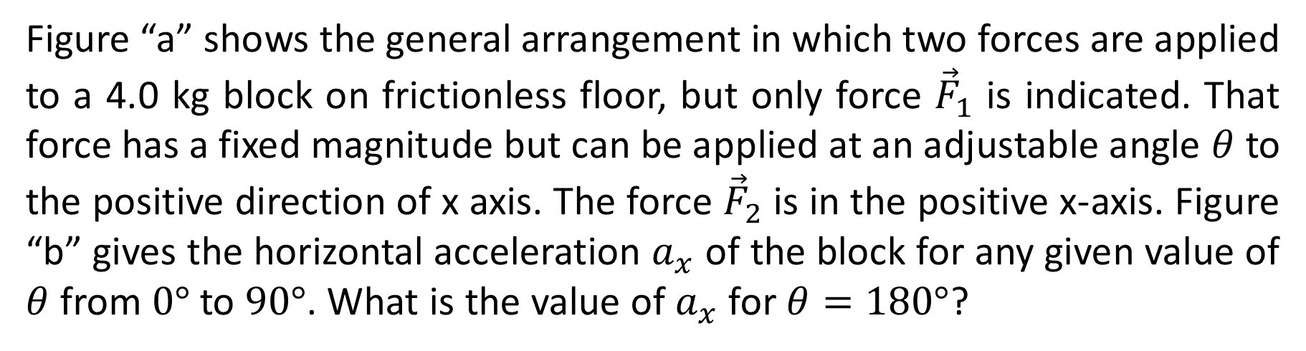
Figure “a” shows the general arrangement in which two forces are applied to a 4.0 kg block on frictionless floor, but only force ${\vec{F}}_{1}$ is indicated. That force has a fixed magnitude but can be applied at an adjustable angle $θ$ to the positive direction of x axis. The force ${\vec{F}}_{2}$ is in the positive x-axis. Figure “b” gives the horizontal acceleration $a_{x}$ of the block for any given value of $θ$ from $0°$ to $90°$. What is the value of $a_{x}$ for $θ=180°$?

Slide 7
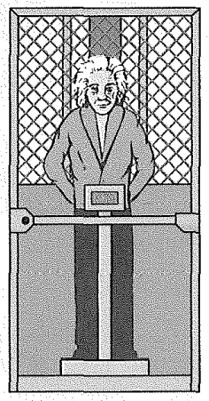
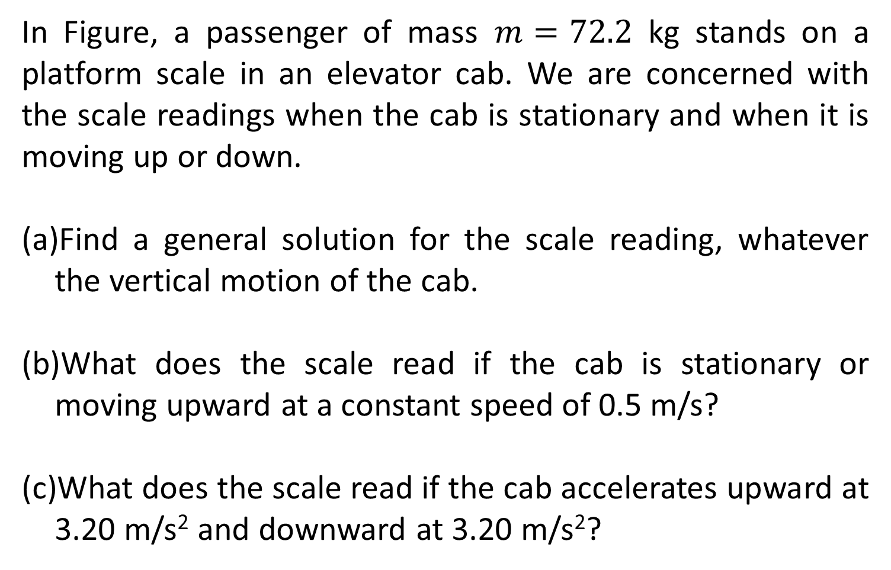
In Figure, a passenger of mass $m=72.2$ kg stands on a platform scale in an elevator cab. We are concerned with the scale readings when the cab is stationary and when it is moving up or down.
Find a general solution for the scale reading, whatever the vertical motion of the cab.
What does the scale read if the cab is stationary or moving upward at a constant speed of 0.5 m/s?
What does the scale read if the cab accelerates upward at 3.20 m/s² and downward at 3.20 m/s²?

Slide 8
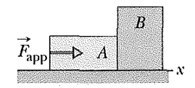
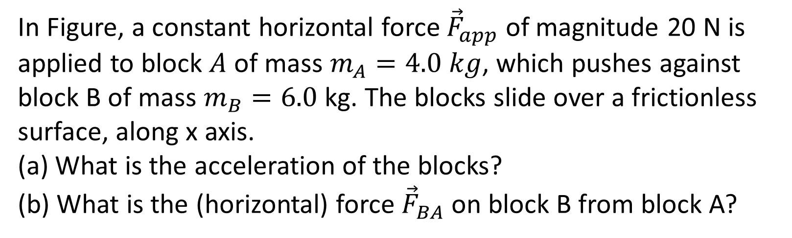
In Figure, a constant horizontal force ${\vec{F}}_{app}$ of magnitude 20 N is applied to block $A$ of mass $m_{A}=4.0 kg$, which pushes against block B of mass $m_{B}=6.0$ kg. The blocks slide over a frictionless surface, along x axis.
What is the acceleration of the blocks?
What is the (horizontal) force ${\vec{F}}_{BA}$ on block B from block A?

